Slide 1
8
7
2
4
1
6
3
9
5
Efficiency
Value

Slide 2
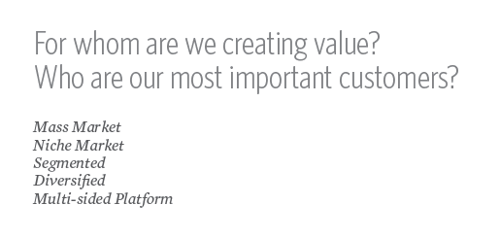
1
1
People or organisations
Free users or paying customers Is there sufficient scope scale? What is the need?

Slide 3
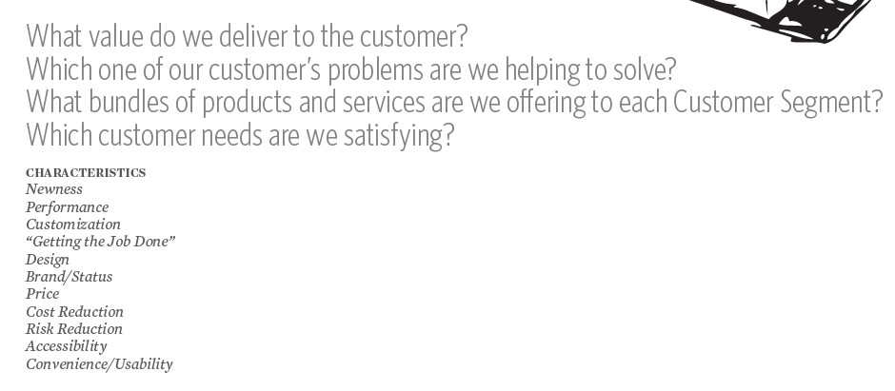
2
2

Slide 4
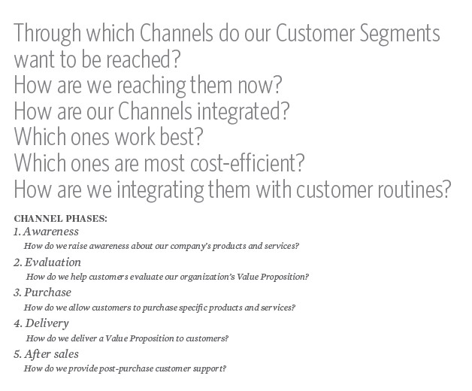
3
3
All customer touchpoints

Slide 5
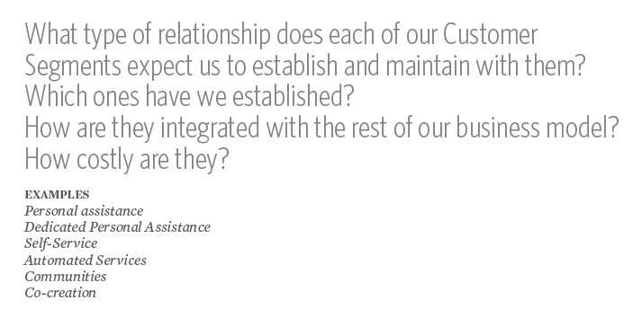
4
4

Slide 6
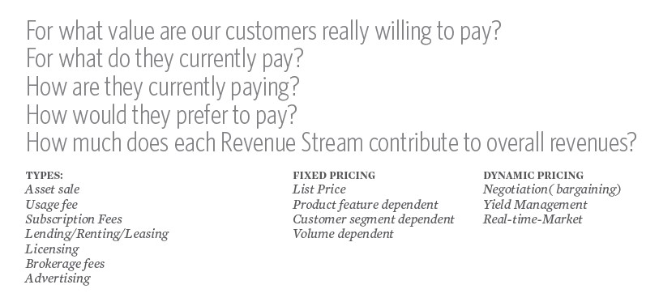
5
5

Slide 7
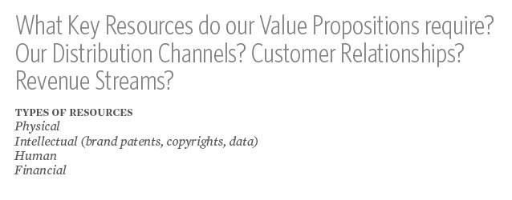
6
6
What infrastructure do you need to
create and deliver value?
Which people/assets are indispensable?

Slide 8
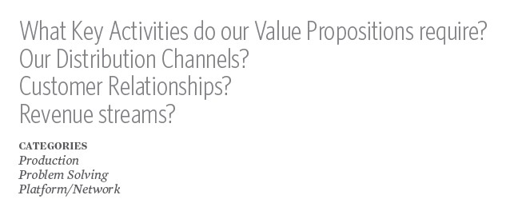
7
7
Service process? Value chain?
Minimum viable functionality?

Slide 9
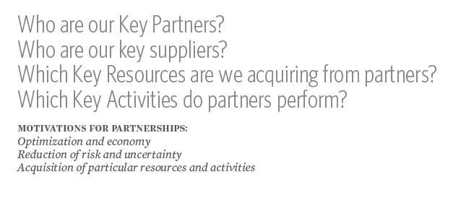
8
8
You can’t do everything yourself! You don’t have all the expertise you need!

Slide 10
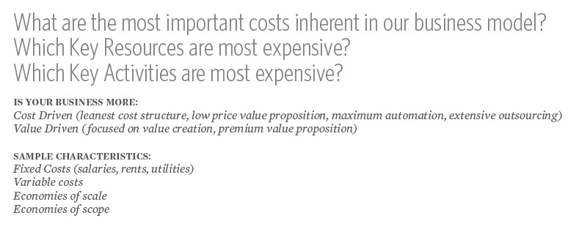
9
Can you make a profit? Are your costs too high? Are you charging enough?
Is your market big enough?
9

